Slide 1
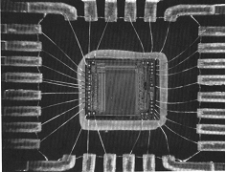
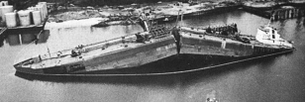
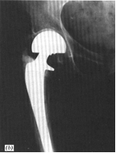
Chapter 8: Mechanical Failure
ISSUES TO ADDRESS...
• How do flaws in a material initiate failure?
• How is fracture resistance quantified; how do different
material classes compare?
• How do we estimate the stress to fracture?
• How do loading rate, loading history, and temperature
affect the failure stress?
Ship-cyclic loading
from waves.
Computer chip-cyclic
thermal loading.
Hip implant-cyclic
loading from walking.

Slide 2
Fracture mechanisms
Ductile fracture
Occurs with plastic deformation
Brittle fracture
Little or no plastic deformation
Catastrophic

Slide 3
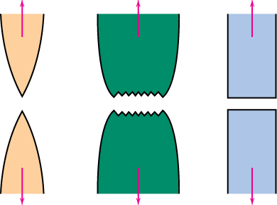
Ductile vs Brittle Failure
• Classification:
Fracture
Very
Moderately
Brittle
behavior:
Ductile
Ductile
%AR or %EL
Large
Moderate
Small
• Ductile
fracture is usually
desirable!
Ductile:
warning before fracture
Brittle: No warning

Slide 4
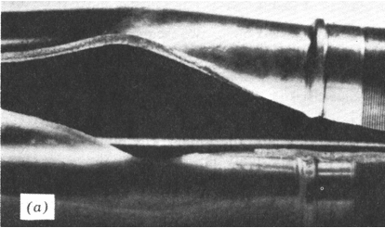
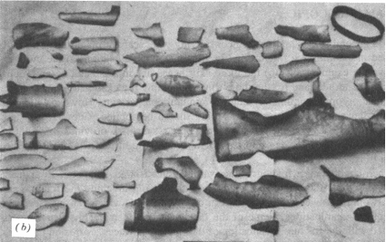
Example: Failure of a Pipe
• Ductile failure:
--one piece
--large deformation
• Brittle failure:
--many pieces
--small deformation

Slide 5
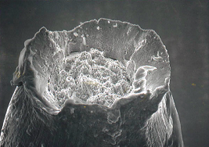
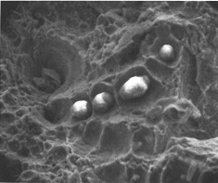
Moderately Ductile Failure
• Evolution to failure:
void
void growth
shearing
necking
and linkage
at surface
fracture
nucleation
σ
50 mm
• Resulting
fracture
surfaces
(steel)
50 mm
100 mm
particles
serve as void
nucleation
sites.
Fracture surface of tire cord wire loaded in tension. Courtesy of F. Roehrig, CC Technologies, Dublin, OH. Used with permission.

Slide 6
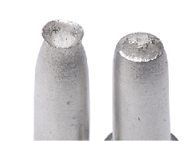
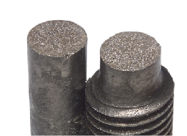
Ductile vs. Brittle Failure
cup-and-cone fracture
brittle fracture

Slide 7
Brittle Failure
Arrows indicate pt at which failure originated

Slide 8
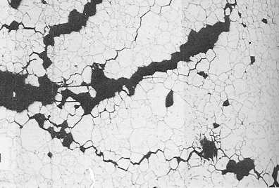
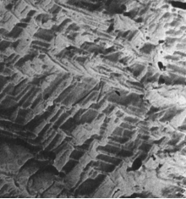

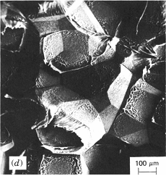
Brittle Fracture Surfaces
• Intergranular
(between grains)
• Intragranular
(within grains)
304 S. Steel (metal)
Reprinted w/permission from "Metals Handbook", 9th ed, Fig. 633, p. 650. Copyright 1985, ASM International, Materials Park, OH. (Micrograph by J.R. Keiser and A.R. Olsen, Oak Ridge National Lab.)
316 S. Steel (metal)
Reprinted w/ permission from "Metals Handbook", 9th ed, Fig. 650, p. 357. Copyright 1985, ASM International, Materials Park, OH. (Micrograph by D.R. Diercks, Argonne National Lab.)
160 mm
4 mm
Polypropylene
(polymer)
Reprinted w/ permission from R.W. Hertzberg, "Deformation and Fracture Mechanics of Engineering Materials", (4th ed.) Fig. 7.35(d), p. 303, John Wiley and Sons, Inc., 1996.
Al Oxide
(ceramic)
Reprinted w/ permission from "Failure Analysis of Brittle Materials", p. 78. Copyright 1990, The American Ceramic Society, Westerville, OH. (Micrograph by R.M. Gruver and H. Kirchner.)
3 mm
1 mm
(Orig. source: K. Friedrick, Fracture 1977, Vol. 3, ICF4, Waterloo, CA, 1977, p. 1119.)

Slide 9
Ideal vs Real Materials
• Stress-strain behavior (Room T):
σ
perfect mat’l-no flaws
TS << TS
E/10
engineering
materials
perfect
materials
carefully produced glass fiber
E/100
typical ceramic
typical strengthened metal
typical polymer
ε
0.1
• DaVinci (500 yrs ago!) observed...
-- the longer the wire, the
smaller the load for failure.
• Reasons:
-- flaws cause premature failure.
-- Larger samples contain more flaws!
Reprinted w/ permission from R.W. Hertzberg, "Deformation and Fracture Mechanics of Engineering Materials", (4th ed.) Fig. 7.4. John Wiley and Sons, Inc., 1996.

Slide 10
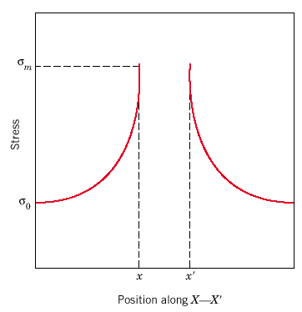
Concentration of Stress at Crack Tip
σ₀

Slide 11
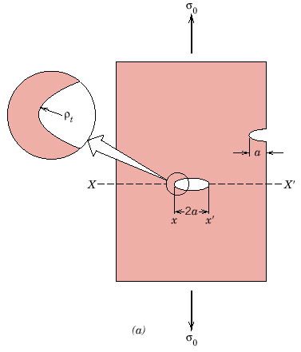
Flaws are Stress Concentrators!
Results from crack propagation
Griffith Crack
where ρ_{t} = radius of curvature
σ_{o} = applied stress
σ_{m} = stress at crack tip
ρ_{t}
Adapted from Fig. 8.8(a), Callister 7e.
Notes:
Stress concentrated at crack tip

Slide 12
Engineering Fracture Design
• Avoid sharp corners!
σ
o
σ
Stress Conc. Factor, K
max
t
=
σ
w
o
σ
max
2.5
r ,
h
fillet
2.0
increasing
w/h
radius
Adapted from Fig. 8.2W(c), Callister 6e.
(Fig. 8.2W(c) is from G.H. Neugebauer, Prod. Eng. (NY), Vol. 14, pp. 82-87 1943.)
1.5
1.0
r/h
0
0.5
1.0
sharper fillet radius

Slide 13
Crack Propagation
Cracks propagate due to sharpness of crack tip
A plastic material deforms at the tip, “blunting” the crack.
deformed region
brittle
Energy balance on the crack
Elastic strain energy-
energy stored in material as it is elastically deformed
this energy is released when the crack propagates
creation of new surfaces requires energy
plastic

Slide 14
When Does a Crack Propagate?
Crack propagates if above critical stress
where
E = modulus of elasticity
γ_{s} = specific surface energy
a = one half length of internal crack
K_{c} = σ_{c}/σ₀
For ductile => replace γ_{s} by γ_{s} + γ_{p}
where γ_{p} is plastic deformation energy
i.e., σ_{m} > σ_{c}
or K_{t} > K_{c}

Slide 15
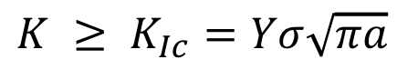
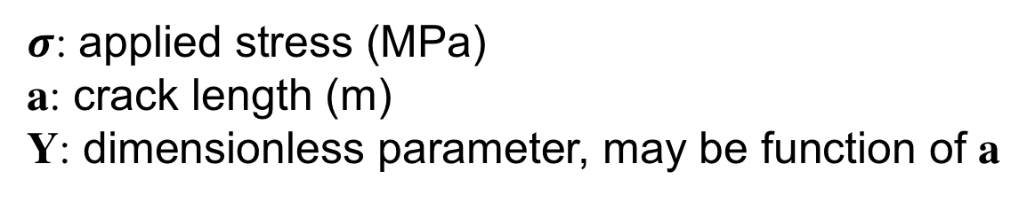
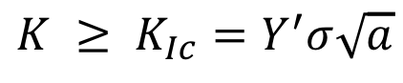
Fracture Toughness
• Crack growth condition:
$$K ≥ K_{Ic}=Yσ\sqrt{πa}$$
Kc: fracture toughness, has units of MPa m^{1/2}
$$K ≥ K_{Ic}=Y^{′}σ\sqrt{a}$$
$σ$: applied stress (MPa)
a: crack length (m)
Y: dimensionless parameter, may be function of a

Slide 16
Crack Displacement Modes
I
tensile
II
sliding
III
tearing

Slide 18
Fracture Toughness
Metals/
Graphite/
Composites/
Alloys
Ceramics/
Polymers
fibers
Semicond
100
C-C
(|| fibers)
1
7
0
Steels
6
0
Ti alloys
5
0
4
0
Al alloys
Based on data in Table B5,
Callister 7e.
Composite reinforcement geometry is: f = fibers; sf = short fibers; w = whiskers; p = particles. Addition data as noted (vol. fraction of reinforcement):
1. (55vol%) ASM Handbook, Vol. 21, ASM Int., Materials Park, OH (2001) p. 606.
2. (55 vol%) Courtesy J. Cornie, MMC, Inc., Waltham, MA.
3. (30 vol%) P.F. Becher et al., Fracture Mechanics of Ceramics, Vol. 7, Plenum Press (1986). pp. 61-73.
4. Courtesy CoorsTek, Golden, CO.
5. (30 vol%) S.T. Buljan et al., "Development of Ceramic Matrix Composites for Application in Technology for Advanced Engines Program", ORNL/Sub/85-22011/2, ORNL, 1992.
6. (20vol%) F.D. Gace et al., Ceram. Eng. Sci. Proc., Vol. 7 (1986) pp. 978-82.
)
3
0
Mg alloys
0.5
2
0
Al/Al oxide(sf)
2
Y
2
O
3
/ZrO
2
(p)
4
10
C/C
( fibers)
1
(MPa · m
Al oxid/SiC(w)
5
3
7
Diamond
Si nitr/SiC(w)
6
Al oxid/ZrO
2
(p)
4
5
Si carbide
PET
Glass/SiC(w)
6
Al oxide
4
Si nitride
Ic
PP
K
3
PVC
2
PC
1
<100>
Glass
6
Si crystal
PS
0.7
<111>
Glass
-
soda
0.6
Concrete
Polyester
0.5

Slide 20
Design Against Crack Growth
• Crack growth condition:
K ≥ K_{c} =
• Largest, most stressed cracks grow first!
--Result 1: Max. flaw size
dictates design stress.
--Result 2: Design stress
dictates max. flaw size.
σ
a_{max}
fracture
fracture
no
no
fracture
a_{max}
fracture
σ

Slide 21
Design Example: Aircraft Wing
• Material has K_{c} = 26 MPa-m^{0.5}
• Two designs to consider...
Design A
--largest flaw is 9 mm
--failure stress = 112 MPa
Design B
--use same material
--largest flaw is 4 mm
--failure stress = ?
• Use...
• Key point: Y and K_{c} are the same in both designs.
--Result:
112 MPa
9 mm
4 mm
Answer:
• Reducing flaw size pays off!

Slide 22
Loading Rate
• Increased loading rate...
-- increases σ_{y} and TS
-- decreases %EL
• Why? An increased rate
gives less time for
dislocations to move past
obstacles.
σ
TS
ε
σ_{y}
larger
ε
TS
smaller
σ_{y}
ε

Slide 23
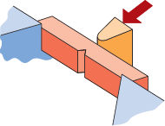
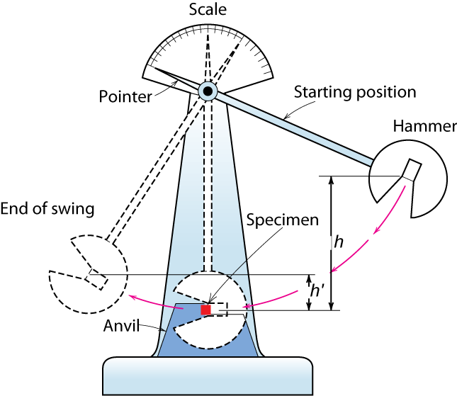
Impact Testing
• Impact loading:
-- severe testing case
-- makes material more brittle
-- decreases toughness
(Charpy)
final height
initial height

Slide 24
Temperature
• Increasing temperature...
--increases %EL and K_{c}
• Ductile-to-Brittle Transition Temperature (DBTT)...
FCC metals (e.g., Cu, Ni)
BCC metals (e.g., iron at T < 914°C)
polymers
Impact Energy
Brittle
More Ductile
High strength materials (
σ
y
> E/150)
Temperature
Ductile-to-brittle
transition temperature

Slide 25
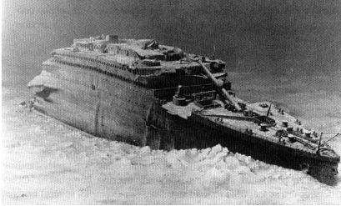
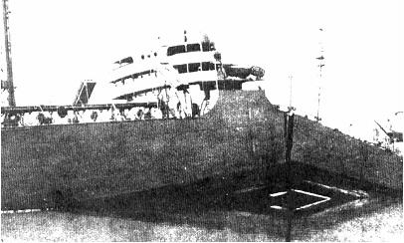
Design Strategy: Stay Above The DBTT!
• Pre-WWII: The Titanic
• WWII: Liberty ships
Reprinted w/ permission from R.W. Hertzberg, "Deformation and Fracture Mechanics of Engineering Materials", (4th ed.) Fig. 7.1(a), p. 262, John Wiley and Sons, Inc., 1996. (Orig. source: Dr. Robert D. Ballard, The Discovery of the Titanic.)
Reprinted w/ permission from R.W. Hertzberg, "Deformation and Fracture Mechanics of Engineering Materials", (4th ed.) Fig. 7.1(b), p. 262, John Wiley and Sons, Inc., 1996. (Orig. source: Earl R. Parker, "Behavior of Engineering Structures", Nat. Acad. Sci., Nat. Res. Council, John Wiley and Sons, Inc., NY, 1957.)
• Problem: Used a type of steel with a DBTT ~ Room temp.

Slide 26
Fatigue
• Fatigue = failure under cyclic stress.
specimen
compression on top
bearing
bearing
motor
counter
flex coupling
tension on bottom
• Stress varies with time.
-- key parameters are S, σ_{m}, and frequency
σ
σ
max
σ
S
m
σ
min
time
• Key points: Fatigue...
--can cause part failure, even though σ_{max} < σ_{c}.
--causes ~ 90% of mechanical engineering failures.

Slide 27
Fatigue Design Parameters
• Fatigue limit, S_{fat}:
--no fatigue if S < S_{fat}
S = stress amplitude
case for
unsafe
steel
(typ.)
S_{fat}
safe
Adapted from Fig. 8.19(a), Callister 7e.
10
3
10
5
10
7
10
9
N = Cycles to failure
• Sometimes, the
fatigue limit is zero!
S = stress amplitude
case for
unsafe
Al
(typ.)
safe
Adapted from Fig. 8.19(b), Callister 7e.
10
3
10
5
10
7
10
9
N = Cycles to failure

Slide 29
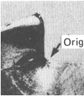
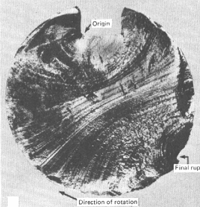
Fatigue Mechanism
• Crack grows incrementally
typ. 1 to 6
increase in crack length per loading cycle
crack origin
• Failed rotating shaft
--crack grew even though
K_{max} < K_{c}
--crack grows faster as
• Δσ increases
• crack gets longer
• loading freq. increases.
Adapted from
Fig. 8.21, Callister 7e. (Fig. 8.21 is from D.J. Wulpi, Understanding How Components Fail, American Society for Metals, Materials Park, OH, 1985.)

Slide 30
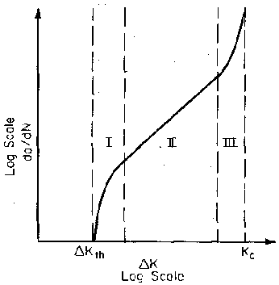
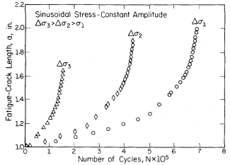
Fatigue Crack Propagation
In region II: da/dN = C (DK)^{m}

Slide 31
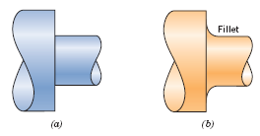
Improving Fatigue Life
1. Impose a compressive
surface stress
(to suppress surface
cracks from growing)
S = stress amplitude
Increasing σ_{m}
σ
near zero or compressive
m
moderate tensile
σ
m
Larger tensile
σ
m
N = Cycles to failure
--Method 1: shot peening
--Method 2: carburizing
shot
put
C-rich gas
surface
into
compression
2. Remove stress
concentrators.
bad
better
Adapted from
Fig. 8.25, Callister 7e.
bad
better

Slide 32
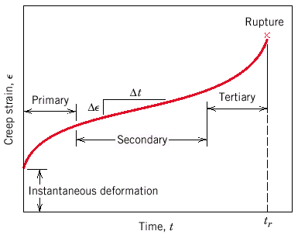
Creep
Sample deformation at a constant stress (σ) vs. time
σ
σ,ε
0
t
Primary Creep: slope (creep rate) decreases with time.
Secondary Creep: steady-state i.e., constant slope.
Tertiary Creep: slope (creep rate) increases with time, i.e. acceleration of rate.
Adapted from
Fig. 8.28, Callister 7e.

Slide 33
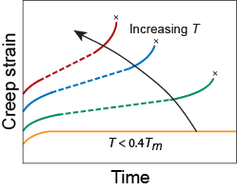
Creep
• Occurs at elevated temperature, T > 0.4 T_{m}
tertiary
primary
secondary
elastic

Slide 34
Secondary Creep
• Strain rate is constant at a given T, σ
-- strain hardening is balanced by recovery
stress exponent (material parameter)
activation energy for creep
(material parameter)
strain rate
material const.
applied stress
• Strain rate
increases
for higher T, σ
Stress (MPa)
Adapted from
Fig. 8.31, Callister 7e.
(Fig. 8.31 is from Metals Handbook: Properties and Selection: Stainless Steels, Tool Materials, and Special Purpose Metals, Vol. 3, 9th ed., D. Benjamin (Senior Ed.), American Society for Metals, 1980, p. 131.)
2
0
0
10
0
427°C
538
°C
4
0
2
0
649
°C
10
10
-2
10
-1
1
ε
Steady state creep rate (%/1000hr)
s

Slide 35
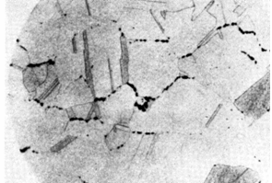
Creep Failure
• Failure:
along grain boundaries.
• Estimate rupture time
S-590 Iron, T = 800°C, σ = 20 ksi
g.b. cavities
Adapted from
Fig. 8.32, Callister 7e.
(Fig. 8.32 is from F.R. Larson and J. Miller, Trans. ASME, 74, 765 (1952).)
100
applied
stress
20
Stress, ksi
10
data for
From V.J. Colangelo and F.A. Heiser, Analysis of Metallurgical Failures (2nd ed.), Fig. 4.32, p. 87, John Wiley and Sons, Inc., 1987. (Orig. source: Pergamon Press, Inc.)
S-590 Iron
12
16
20
24
28
1
L(10
3
K-log hr)
24x10³ K-log hr
• Time to rupture, t_{r}
temperature
function of
applied stress
1073K
time to failure (rupture)
Ans: t_{r} = 233 hr

Slide 36
SUMMARY
• Engineering materials don't reach theoretical strength.
• Flaws produce stress concentrations that cause
premature failure.
• Sharp corners produce large stress concentrations
and premature failure.
• Failure type depends on T and stress:
- for noncyclic σ and T < 0.4T_{m}, failure stress decreases with:
- increased maximum flaw size,
- decreased T,
- increased rate of loading.
- for cyclic σ:
- cycles to fail decreases as Δσ increases.
- for higher T (T > 0.4T_{m}):
- time to fail decreases as σ or T increases.

